Slide 1
Fine Particle characterization
Dr. Swambabu varanasi

Slide 2
Sieve analysis
Lowest mesh screen – 200 mesh size – 75 micron
S.NO | Particle size (mm) | M*10^-1 (kg)
0 | 0.063
1 | 0.09 | 0.1
2 | 0.125 | 0.27
3 | 0.18 | 1.03
4 | 0.25 | 2.2
5 | 0.355 | 5.4
6 | 0.5 | 9.3
7 | 0.71 | 13.7
8 | 1 | 17
9 | 1.4 | 17
10 | 2 | 14.6
11 | 2.8 | 9.9
12 | 4 | 5.6
13 | 5.6 | 2.4
14 | 8 | 1.1
15 | 11.2 | 0.3
16 | 16 | 0.1

Slide 3
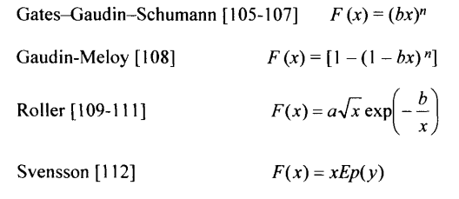
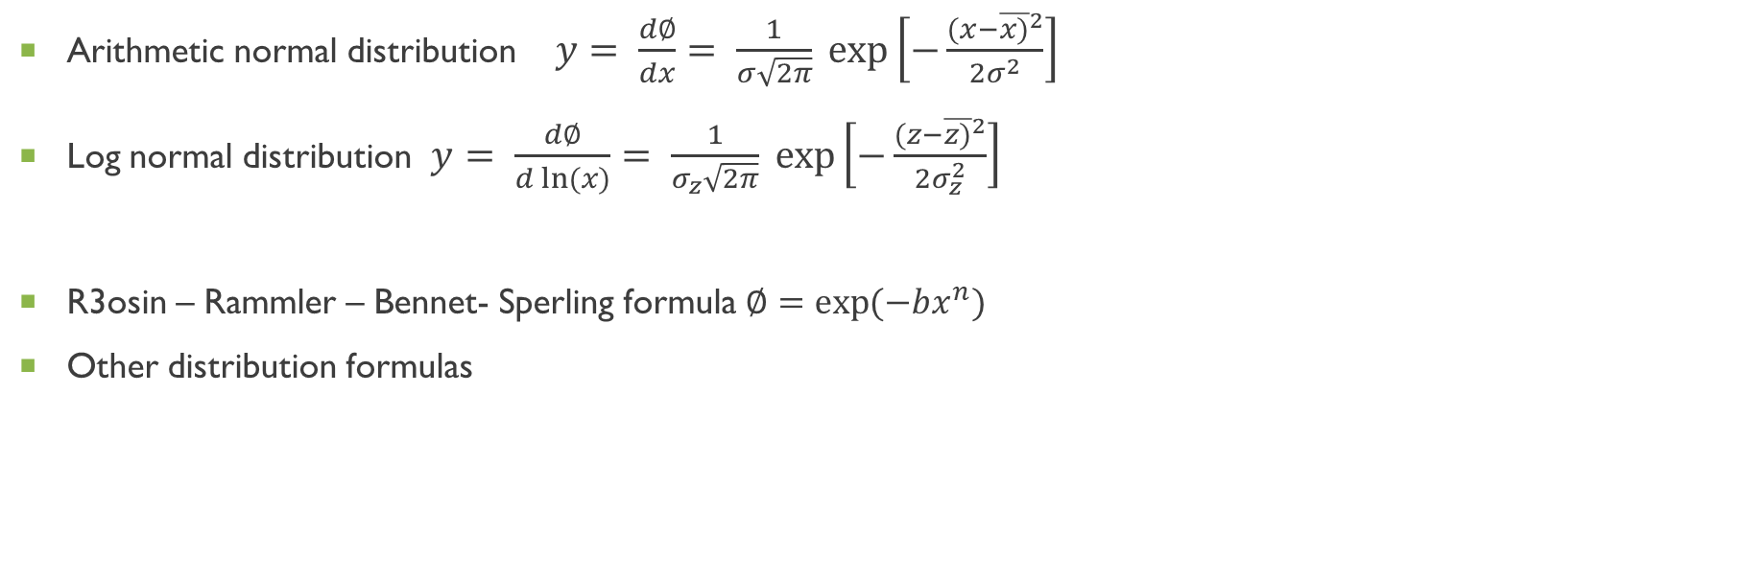
Distribution function
Arithmetic normal distribution $y= \frac{d∅}{dx}= \frac{1}{σ\sqrt{2π}} exp\left[−\frac{{(x−\overline{x)}}^{2}}{2σ^{2}}\right]$
Log normal distribution $y= \frac{d∅}{d ln⁡(x)}= \frac{1}{σ_{z}\sqrt{2π}} exp\left[−\frac{{(z−\overline{z)}}^{2}}{2σ_{z}^{2}}\right]$
R3osin – Rammler – Bennet- Sperling formula $∅=\exp{(−bx^{n})}$
Other distribution formulas

Slide 4
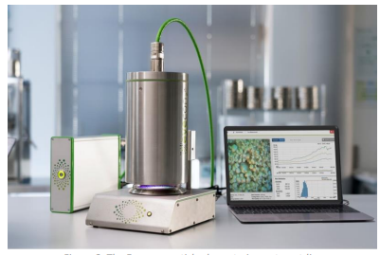
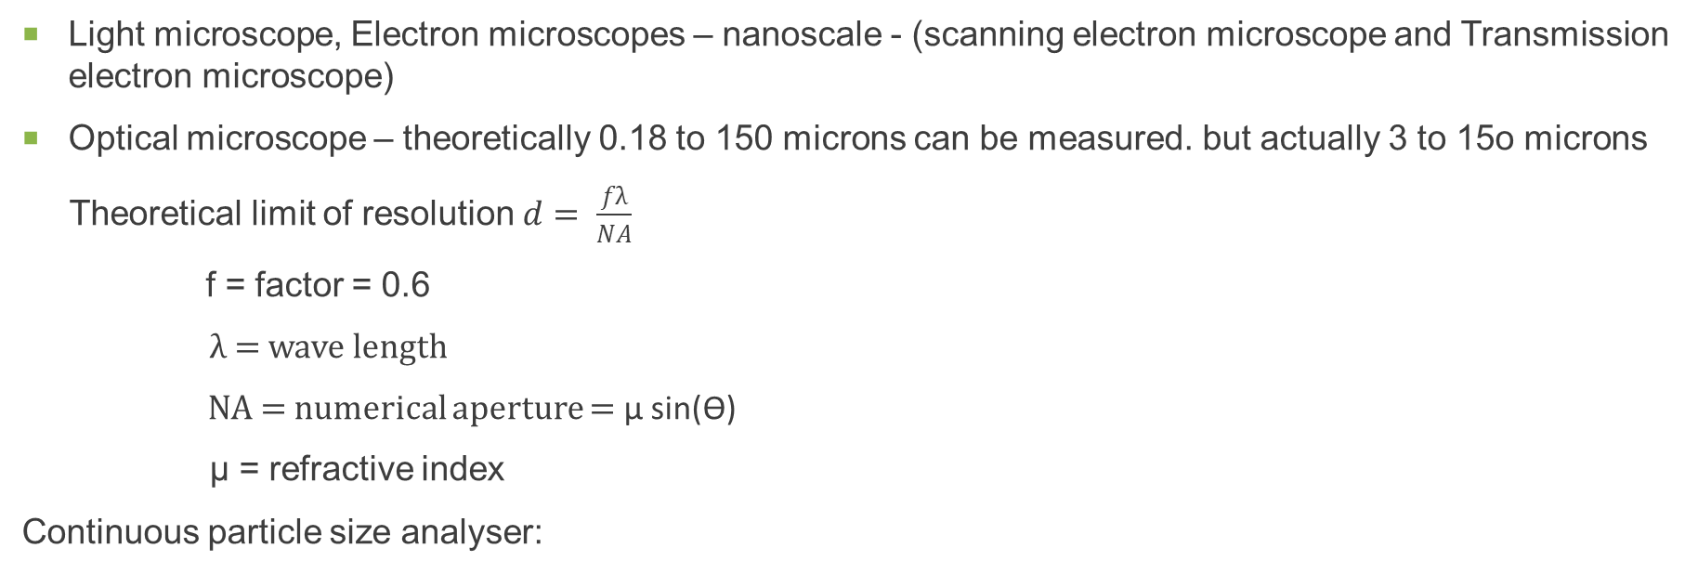
Microscopic Techniques
Light microscope, Electron microscopes – nanoscale - (scanning electron microscope and Transmission electron microscope)
Optical microscope – theoretically 0.18 to 150 microns can be measured. but actually 3 to 15o microns
Theoretical limit of resolution $d= \frac{fλ}{NA}$
f = factor = 0.6
λ = wave length
NA = numerical aperture = μ sin(ϴ)
μ = refractive index
Continuous particle size analyser:

Slide 5
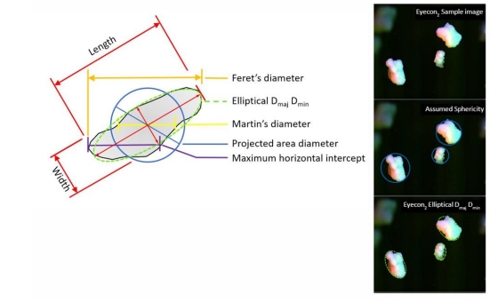
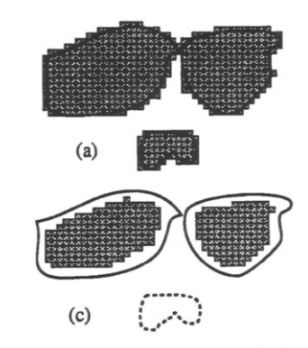
Image analysers

Slide 6
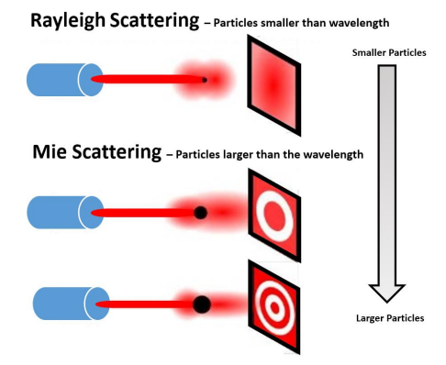
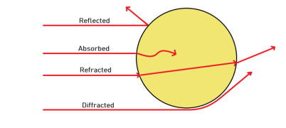


Laser diffraction
HeNe laser with incident wavelength 638.2 nm
Rayleigh scattering
Mie Scattering
https://www.youtube.com/watch?v=kll3kg9yXDw

Slide 7
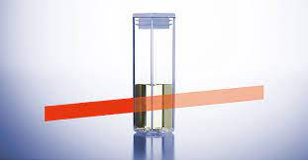
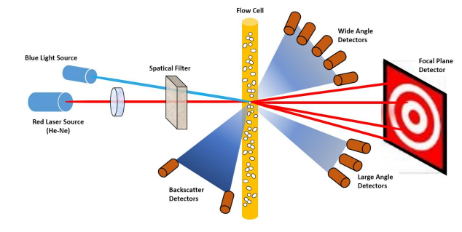
Laser diffraction
Cuvettes

Slide 8
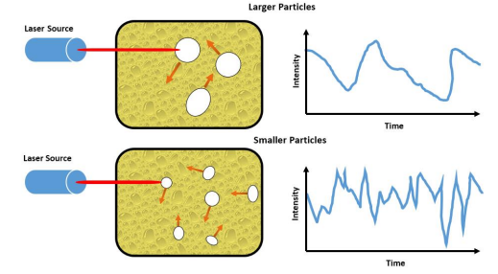
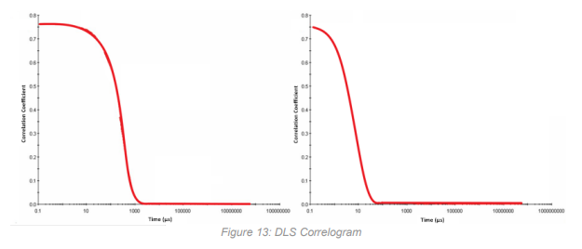



Dynamic light scattering (DLS)
Einstein – Stokes law
D_{T} = Diffusion coefficient
Hydrodynamic diameter
n = refractive index
λ = wave length
ϴ = scatter angle
k_{B} = Boltzmann's constant T = temperature ὴ = viscosity

Slide 9
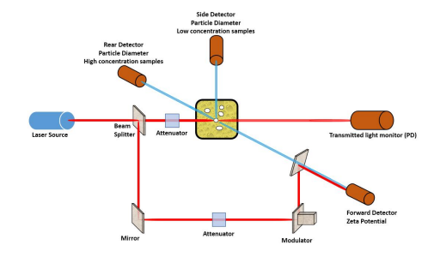
DLS

